Slide 1
Tourism
Hongbo Liu, Ziyi Zhao, Yuxuan (Leo) Liu,
Jingze Zhang, Erya Ouyang

Slide 2
INTRODUCTION
Motivation & Background of our practicum | Questions explored & answered.
Motivation
&
Background
Safety Issue (staying 15+ days with higher probability of illegal immigration)
Improve London Tourism Industry’s Development
“Whether visitors coming from certain countries have higher probability to stay 15+ days in Great London Area?”

Slide 3
DATA PROCESSING
Clean & Merge two datasets | Prepare & Explore data before modeling
Descriptive Analysis
Data Manipulation
Datasets
Descriptive Analysis
Data Manipulation
International Tourism Data
Prosperity Index Data
Skewness
Different Scales
Standardization
Target Encoding
Feature Selection
GOOGLE CHROME

Slide 4
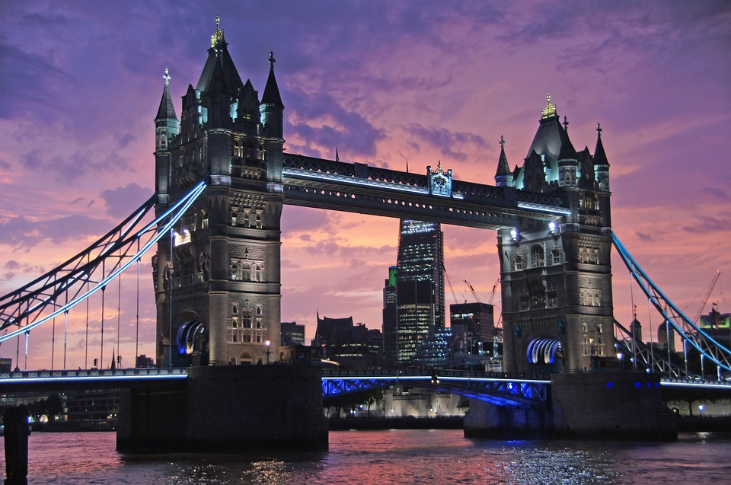

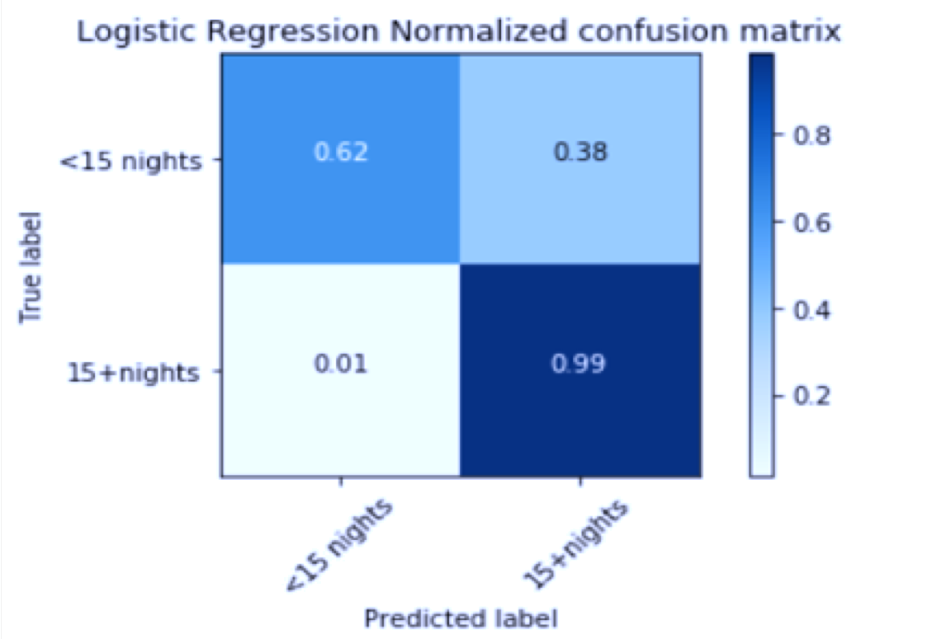
MODEL
Model Selection | Logistic Regression Model
 | Precision | Recall | F1-score | Support
< 15 nights | 0.90 | 0.64 | 0.75 | 1698
≥ 15 nights | 0.92 | 0.98 | 0.95 | 7596
Avg /Total | 0.92 | 0.92 | 0.92 | 9294
Four shorts words a sums up what has lifted you most successful.
Experience as you are.亮亮图文旗舰店https://liangliangtuwen.tmall.com

Slide 5
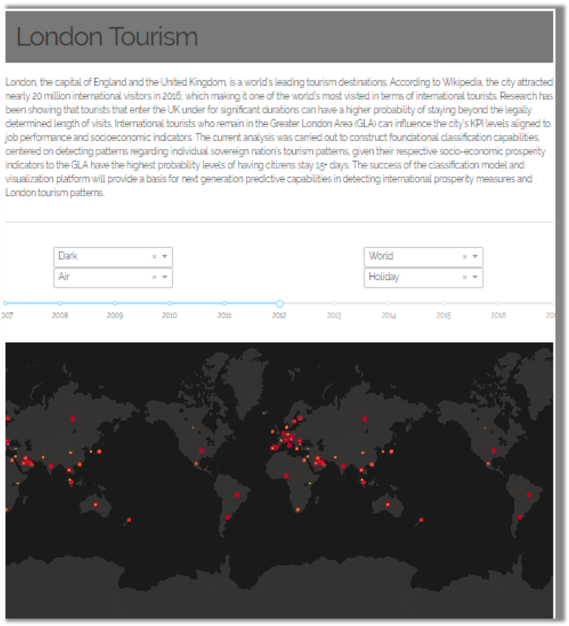
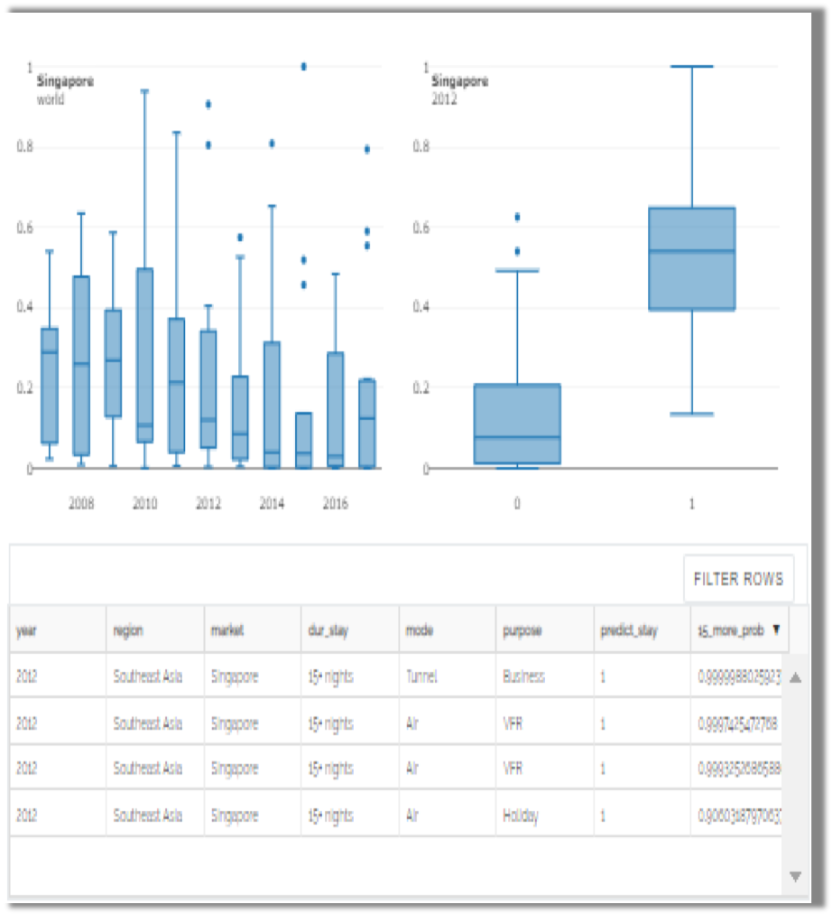
DASHBOARD
Use Python Dash Package to Visualize Model Results

Slide 6
CONCLUSION
Results & Recommendation | Future Work | Project Impact
Enhance Customs Inspection
Background Check
Recommendation
Model Tuning
Stimulate London Economy Development by Tracking International Tourists
Consumption Pattern
Future Work
Rebuild City Safety Management System on Illegal Immigrants
Apply London Tourism Analytics Prototype on Other Cities
Impact

Slide 7


THANK YOU
For this semester-long practicum, we appreciate all helps from Mentors of Deloitte and GWU professors
We also appreciate all team member’s contribution and it is a great atmosphere working together
Descriptive Appendix
Data Processing Appendix
Model Appendix
Others Appendix

Slide 8

Descriptive Appendix
Countries Distribution & Counts
Purposes by Countries & Counts
Purposes, Nights, Spend by Year
Duration of Stay & Purpose Counts
Country & Safety
Spend, Visits and Average safe index
Bottom 10 countries by Spend, Visits and Average safe index

Slide 9
Data Processing Appendix
Country Merging Table
Frequency of Visits/ Spend/ Nights
Scatter Plot between Nights per Visit & Spend per Visit
Countries with high dur_stay but low spend
Feature Selection on the Importance of Variable

Slide 10
Model Appendix
Models Accuracy and Variance
Logistic Regression Confusion Matrix
Kernel Support Vector Confusion Matrix
Decision Tree Confusion Matrix
Random Forest Confusion Matrix
K Nearest Neighbors Confusion Matrix
Naïve Bayes Confusion Matrix

Slide 11
Others Appendix
Scatter Plot of Average Nights Versus Average Spending on Different Countries
Average Spend by Country
International Tourism Visits & Spend Trend

Slide 12
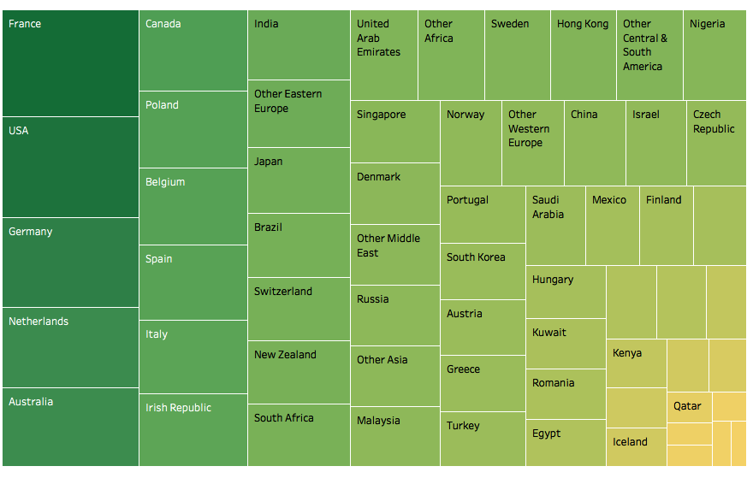

Descriptive Appendix
Countries Distribution & Counts

Slide 13
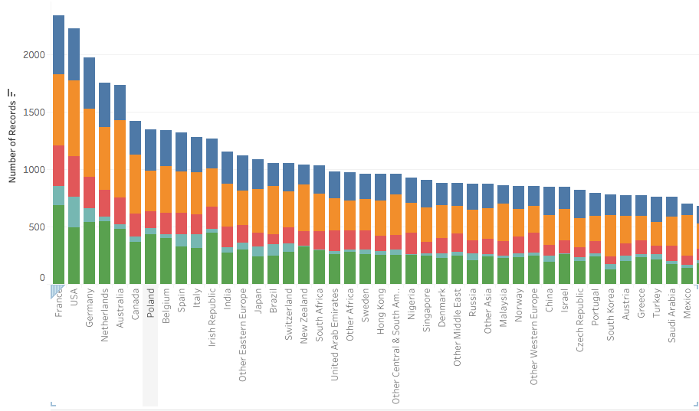
Descriptive Appendix
Purposes by Countries & Counts

Slide 14
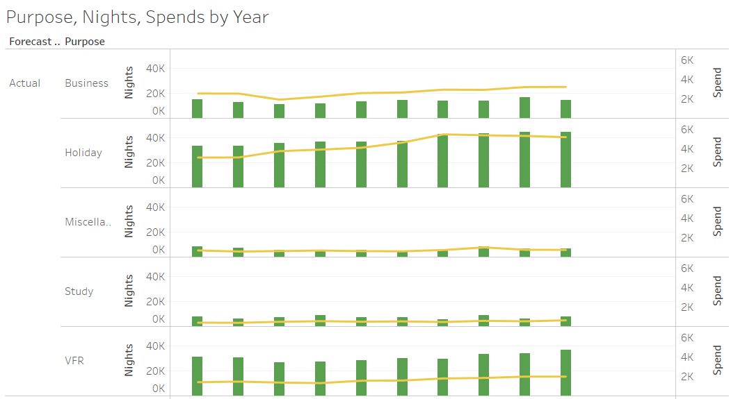
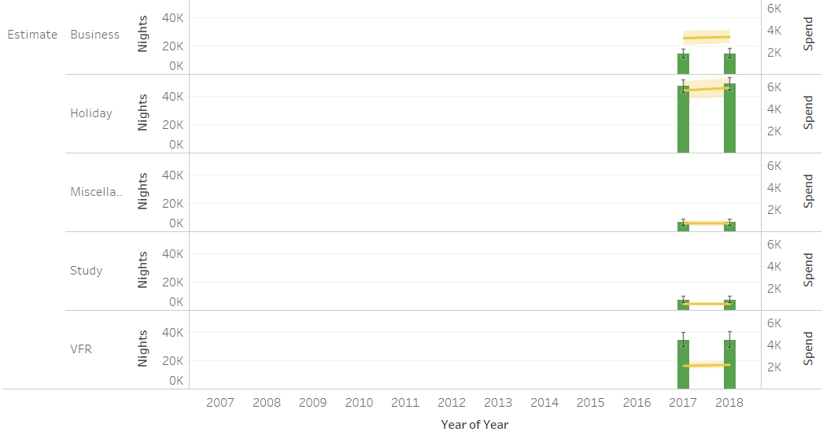
Descriptive Appendix
Purposes, Nights, Spend by Year

Slide 15
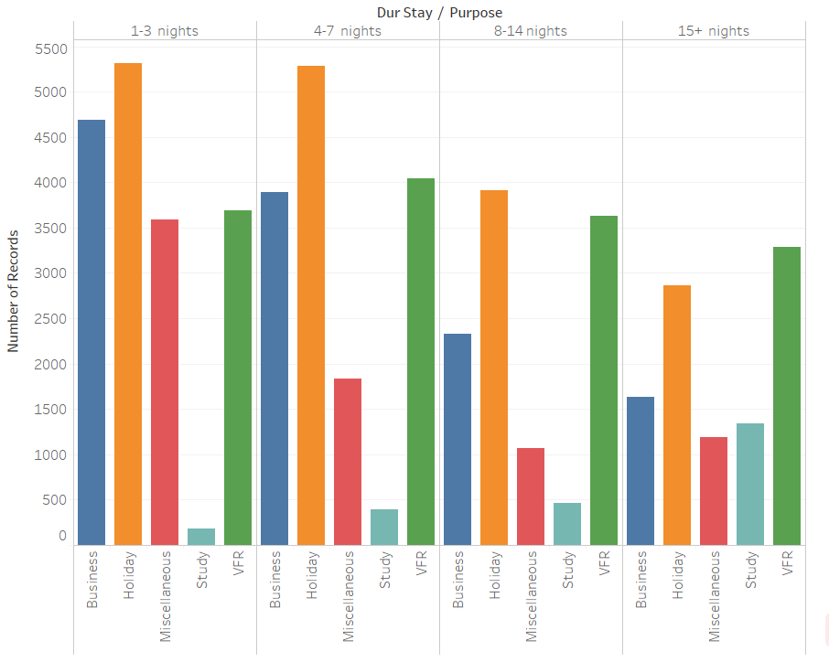
Descriptive Appendix
Duration of Stay & Purpose Counts

Slide 16
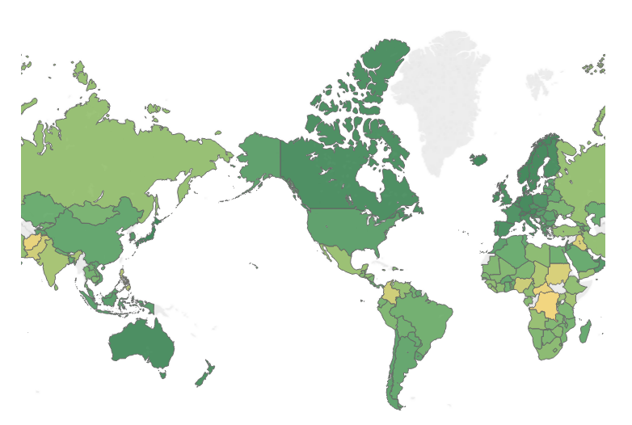
Descriptive Appendix
Country & Safety

Slide 17
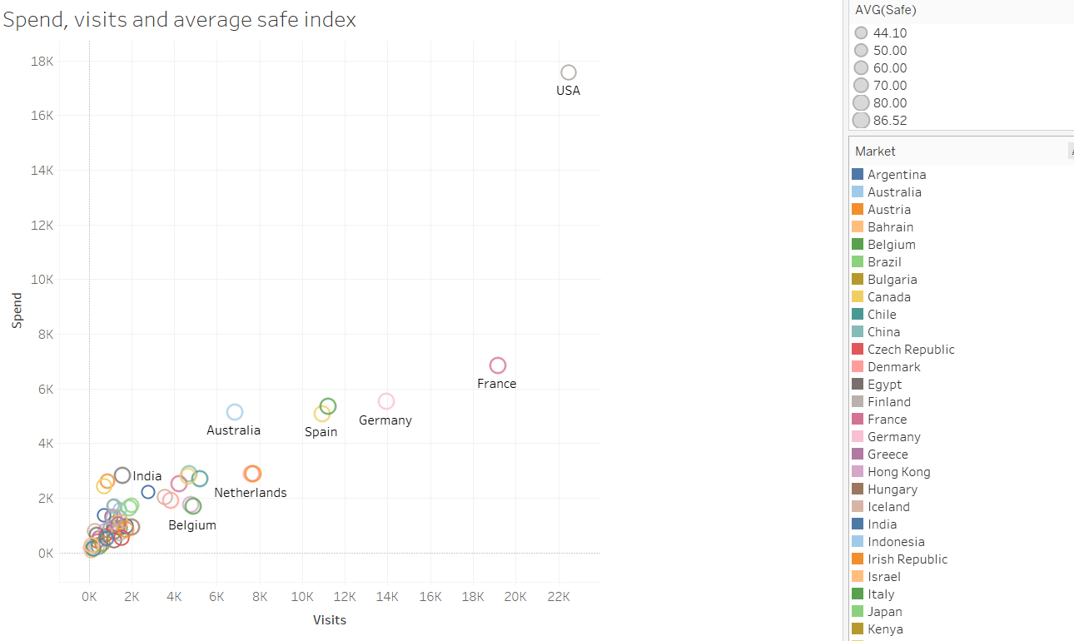
Descriptive Appendix
Spend, Visits and Average safe index

Slide 18
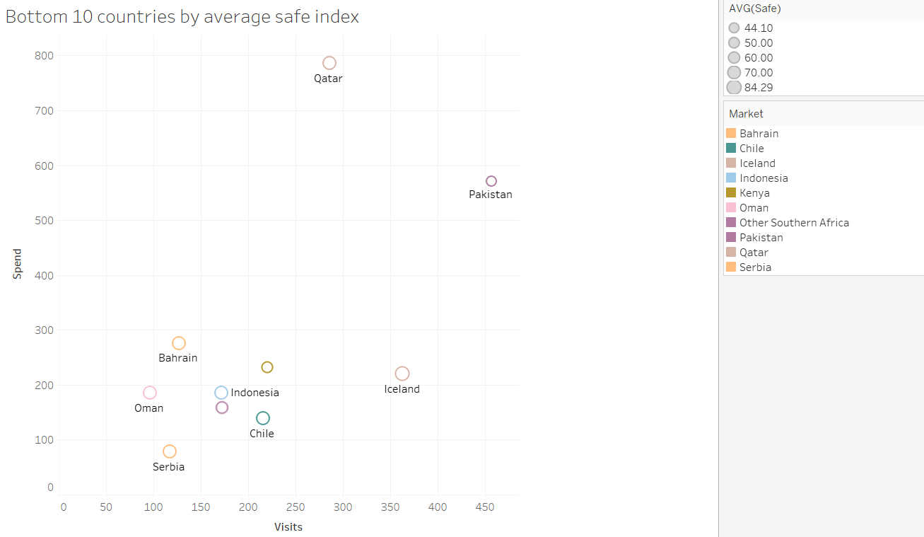
Descriptive Appendix
Bottom 10 countries by Spend, Visits and Average safe index

Slide 19
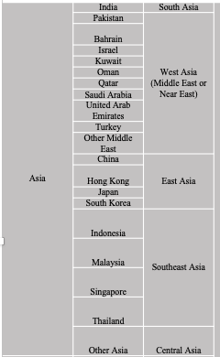
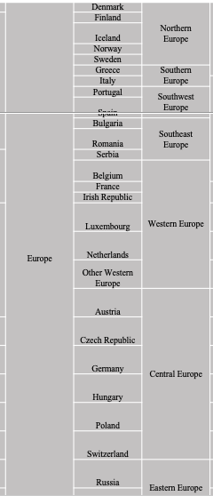
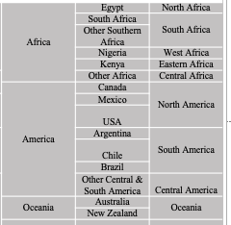
Data Processing Appendix
Country Merging Table

Slide 20
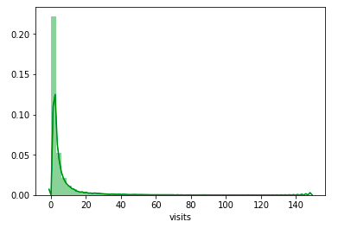
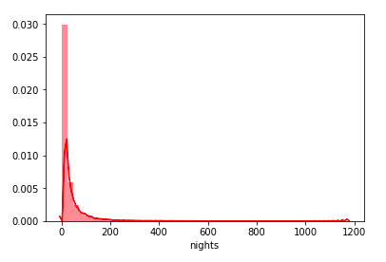
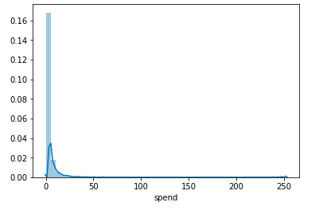
Data Processing Appendix
Frequency of Visits/ Spend/ Nights

Slide 21
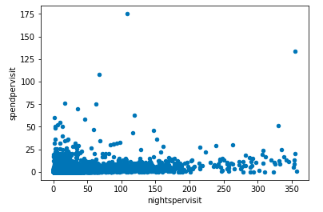
Data Processing Appendix
Scatter Plot between Nights per Visit & Spend per Visit

Slide 22
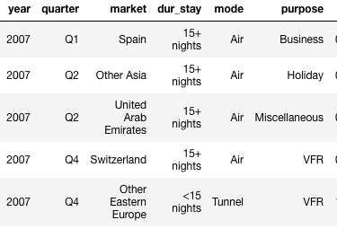
Data Processing Appendix
Countries with high dur_stay but low spend

Slide 23
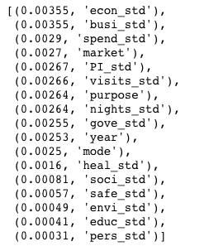
Data Processing Appendix
Feature Selection on the Importance of Variable

Slide 24
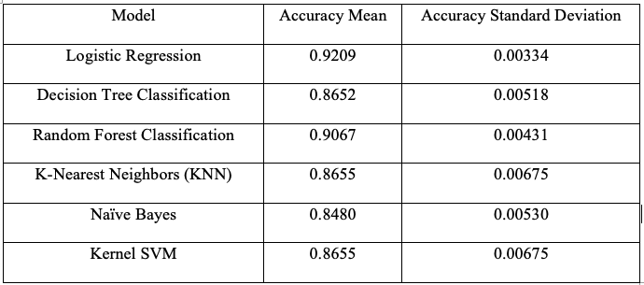
Model Appendix
Models Accuracy and Variance

Slide 25
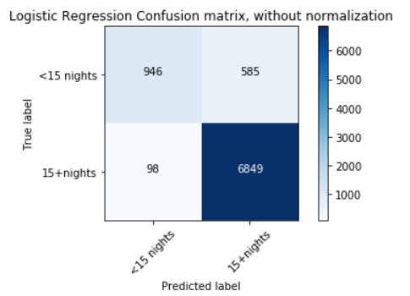
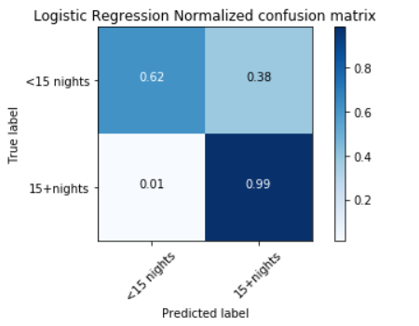
Model Appendix
Logistic Regression Confusion Matrix

Slide 26
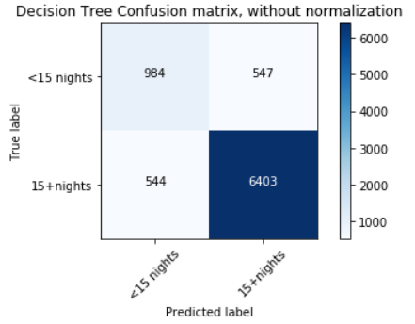
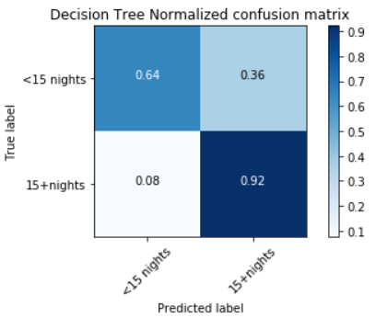
Model Appendix
Decision Tree Confusion Matrix

Slide 27
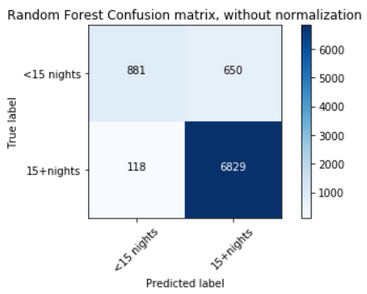
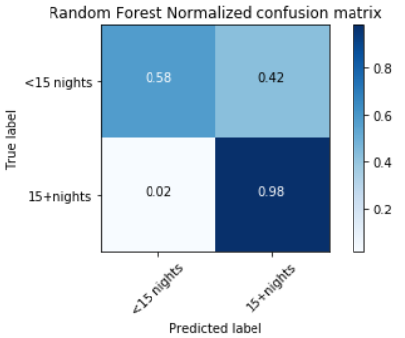
Model Appendix
Random Forest Confusion Matrix

Slide 28
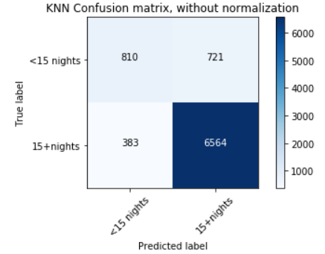
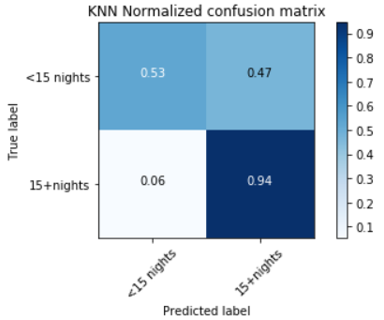
Model Appendix
K Nearest Neighbors Confusion Matrix

Slide 29
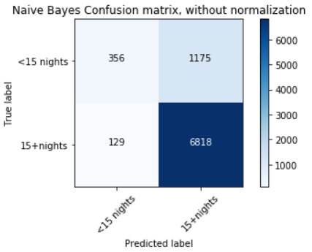
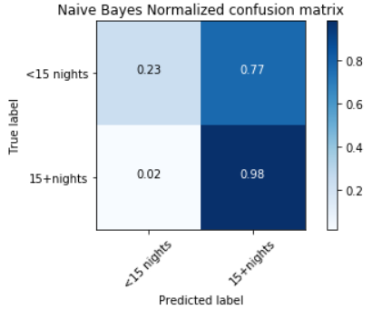
Model Appendix
Naïve Bayes Confusion Matrix

Slide 30
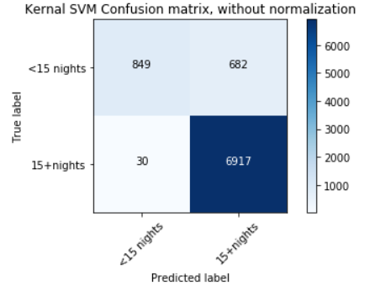
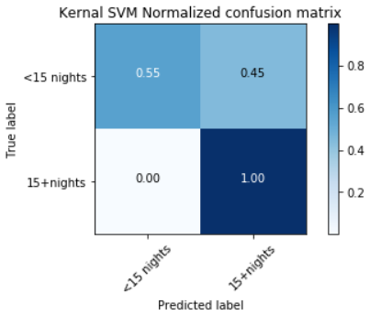
Model Appendix
Kernel Support Vector Confusion Matrix

Slide 31
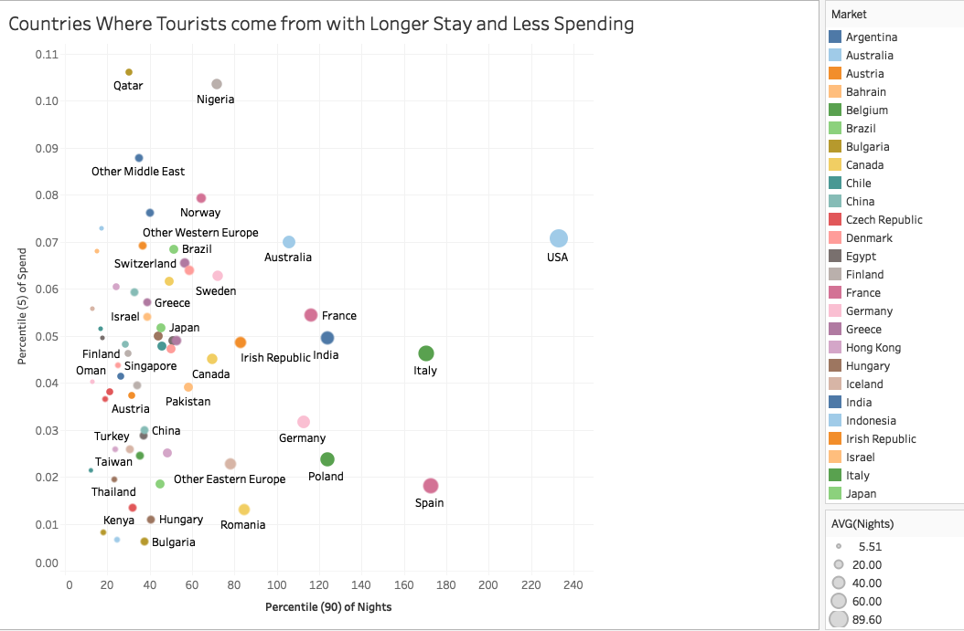
Others Appendix
Scatter Plot of Average Nights Versus Average Spending on Different Countries

Slide 32
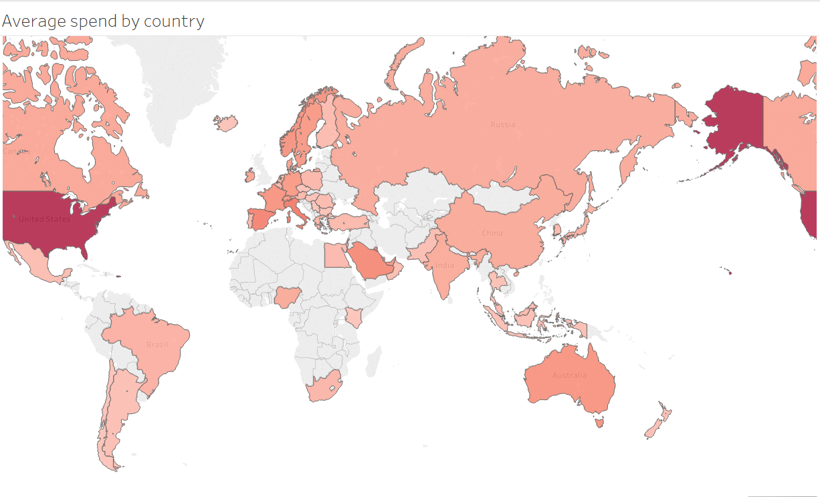
Others Appendix
Average Spend by Country

Slide 33
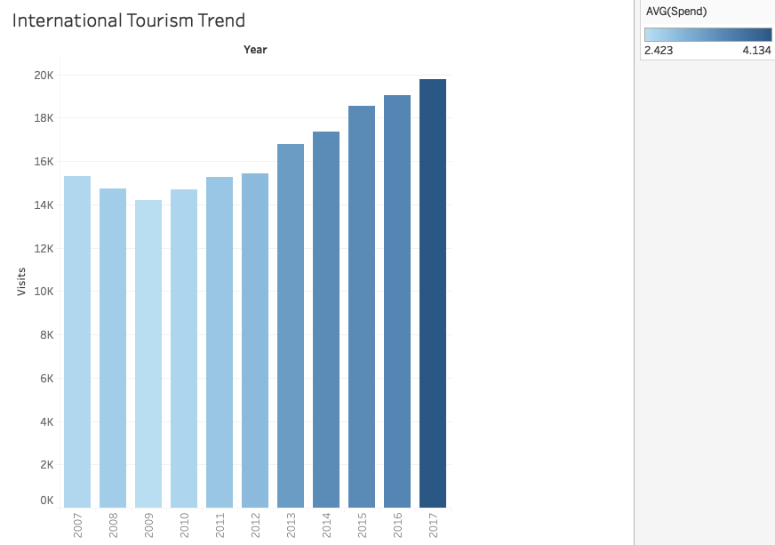
Others Appendix
International Tourism Visits & Spend Trend

Slide 34


THANK YOU

